Slide 1


Classification Of emails using machine learning
The Topic classification of emails using machine learning is a practical application that ties together concepts from all four units.

Slide 2
Unit 1: Introduction to Artificial Intelligence
Connection: Email topic classification is an AI application because it mimics human-like decision-making — deciding whether an email belongs to “Work,” “Personal,” “Promotions,” etc.
Concepts involved:
AI definition: building systems that perceive, reason, and act.
Email classification is an example of narrow AI (specialized task).
It demonstrates how AI impacts real-world domains like communication and productivity.

Slide 3
Unit 2: Intelligent Agent and Problem Solving
Connection: The classifier can be seen as an intelligent agent.
Agent perspective:
• Perception: Reads the text of the email.
• Reasoning: Uses algorithms to decide the most likely topic.
• Action: Assigns the email to a folder or label.
Problem-solving aspect:
• The problem is “Given an email, determine its topic.”
• The solution involves searching through possible categories and selecting the best one.
• This aligns with the agent problem-solving cycle.

Slide 4
Unit 3: Knowledge Representation and Inference
Connection: To classify emails, the system must represent knowledge about language and topics.
Examples:
• Bag-of-Words / TF-IDF: Representing text as numerical features.
• Semantic embeddings (Word2Vec, BERT): Capturing meaning of words and context.
• Inference: The system infers the most probable topic from these representations.
Relation to AI theory: Shows how symbolic representation (keywords, rules) and statistical representation (vectors, embeddings) both play roles in modern AI.

Slide 5
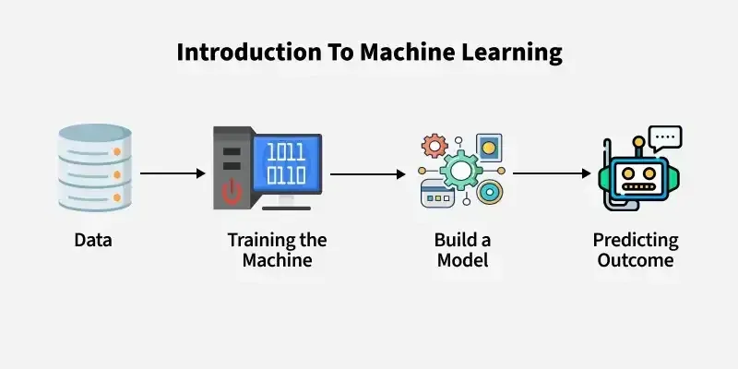
Unit 4: Introduction to Machine Learning
Connection: This is the core engine of email classification.
ML techniques used:
• Supervised learning: Training on labeled emails (e.g., “Work,” “Spam,” “Social”).
• Algorithms: Naïve Bayes, Logistic Regression, SVM, Decision Trees, or Deep Learning models like LSTMs and Transformers.
• Evaluation: Accuracy, precision, recall, F1-score to measure performance.
Practical outcome: The ML model generalizes from training data to classify unseen emails.

